Slide 1
Copilot in Fabric

Slide 2
You can simply count Copilot usage against your existing Fabric or Power BI Premium capacity just like any other Fabric capability.
Copilot in Microsoft Fabric
Copilot in Fabric usage is charged at a rate of 100 Capacity Units seconds per 1,000 input tokens and 400 Capacity Units seconds per 1,000 output tokens.
See full details here:
https://aka.ms/Copilot-Billing-Docs.

Slide 3

Making Copilot in Fabric and data agents more accessible
Expanding access to all users
New Copilot capacity
Expanding Copilot to all F-SKUs: Copilot and AI capabilities will be enabled for all paid SKUs in Fabric.
Organizations with multiple capacities can direct Copilot consumption and billing to a specific capacity, no matter where the usage takes place.
Rate reduction: We’ve reduced the Copilot in Fabric consumption rate by ~70% since launch.
Admins can assign specific users to a specific capacity for all their Copilot requests, ensuring their requests don’t impact priority jobs.

Slide 4
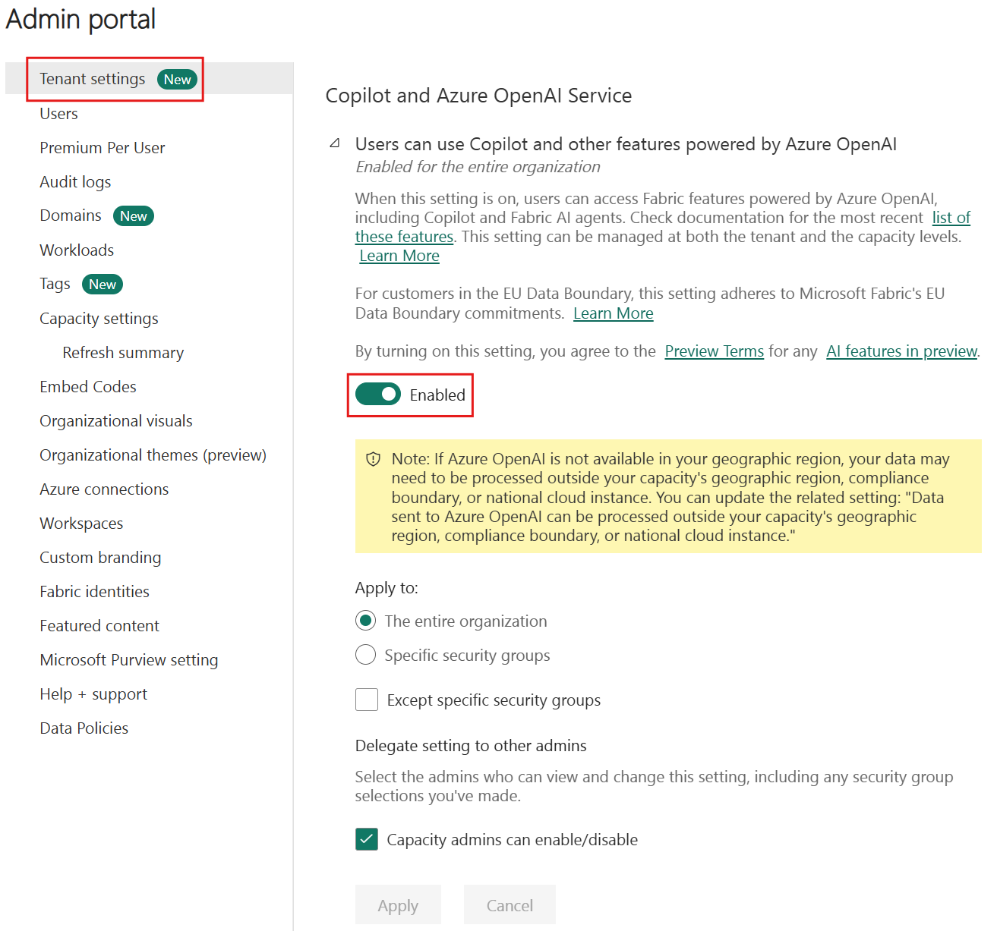
Settings for Copilot Tenants
Fabric Copilot settings are controlled by the Copilot and Azure OpenAI Service tenant settings group.​ There are multiple settings governing user access and data processing policies, and some of them are enabled by default whereas others require the Fabric administrator to enable them.

Slide 5
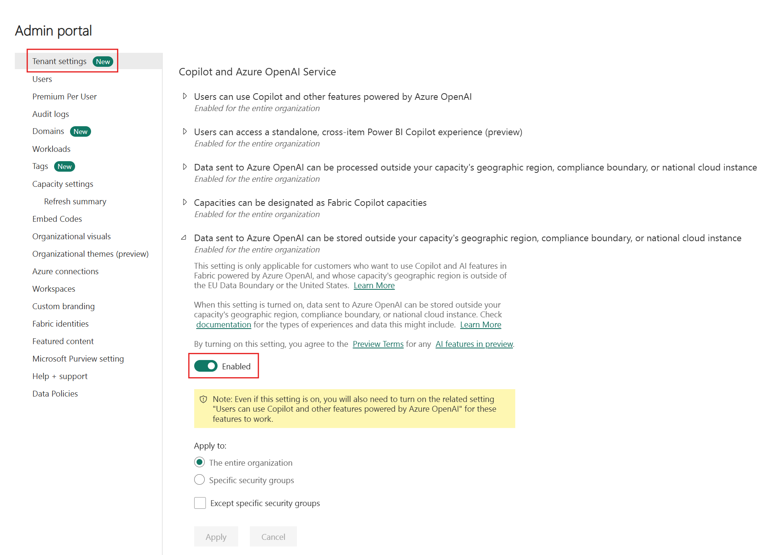
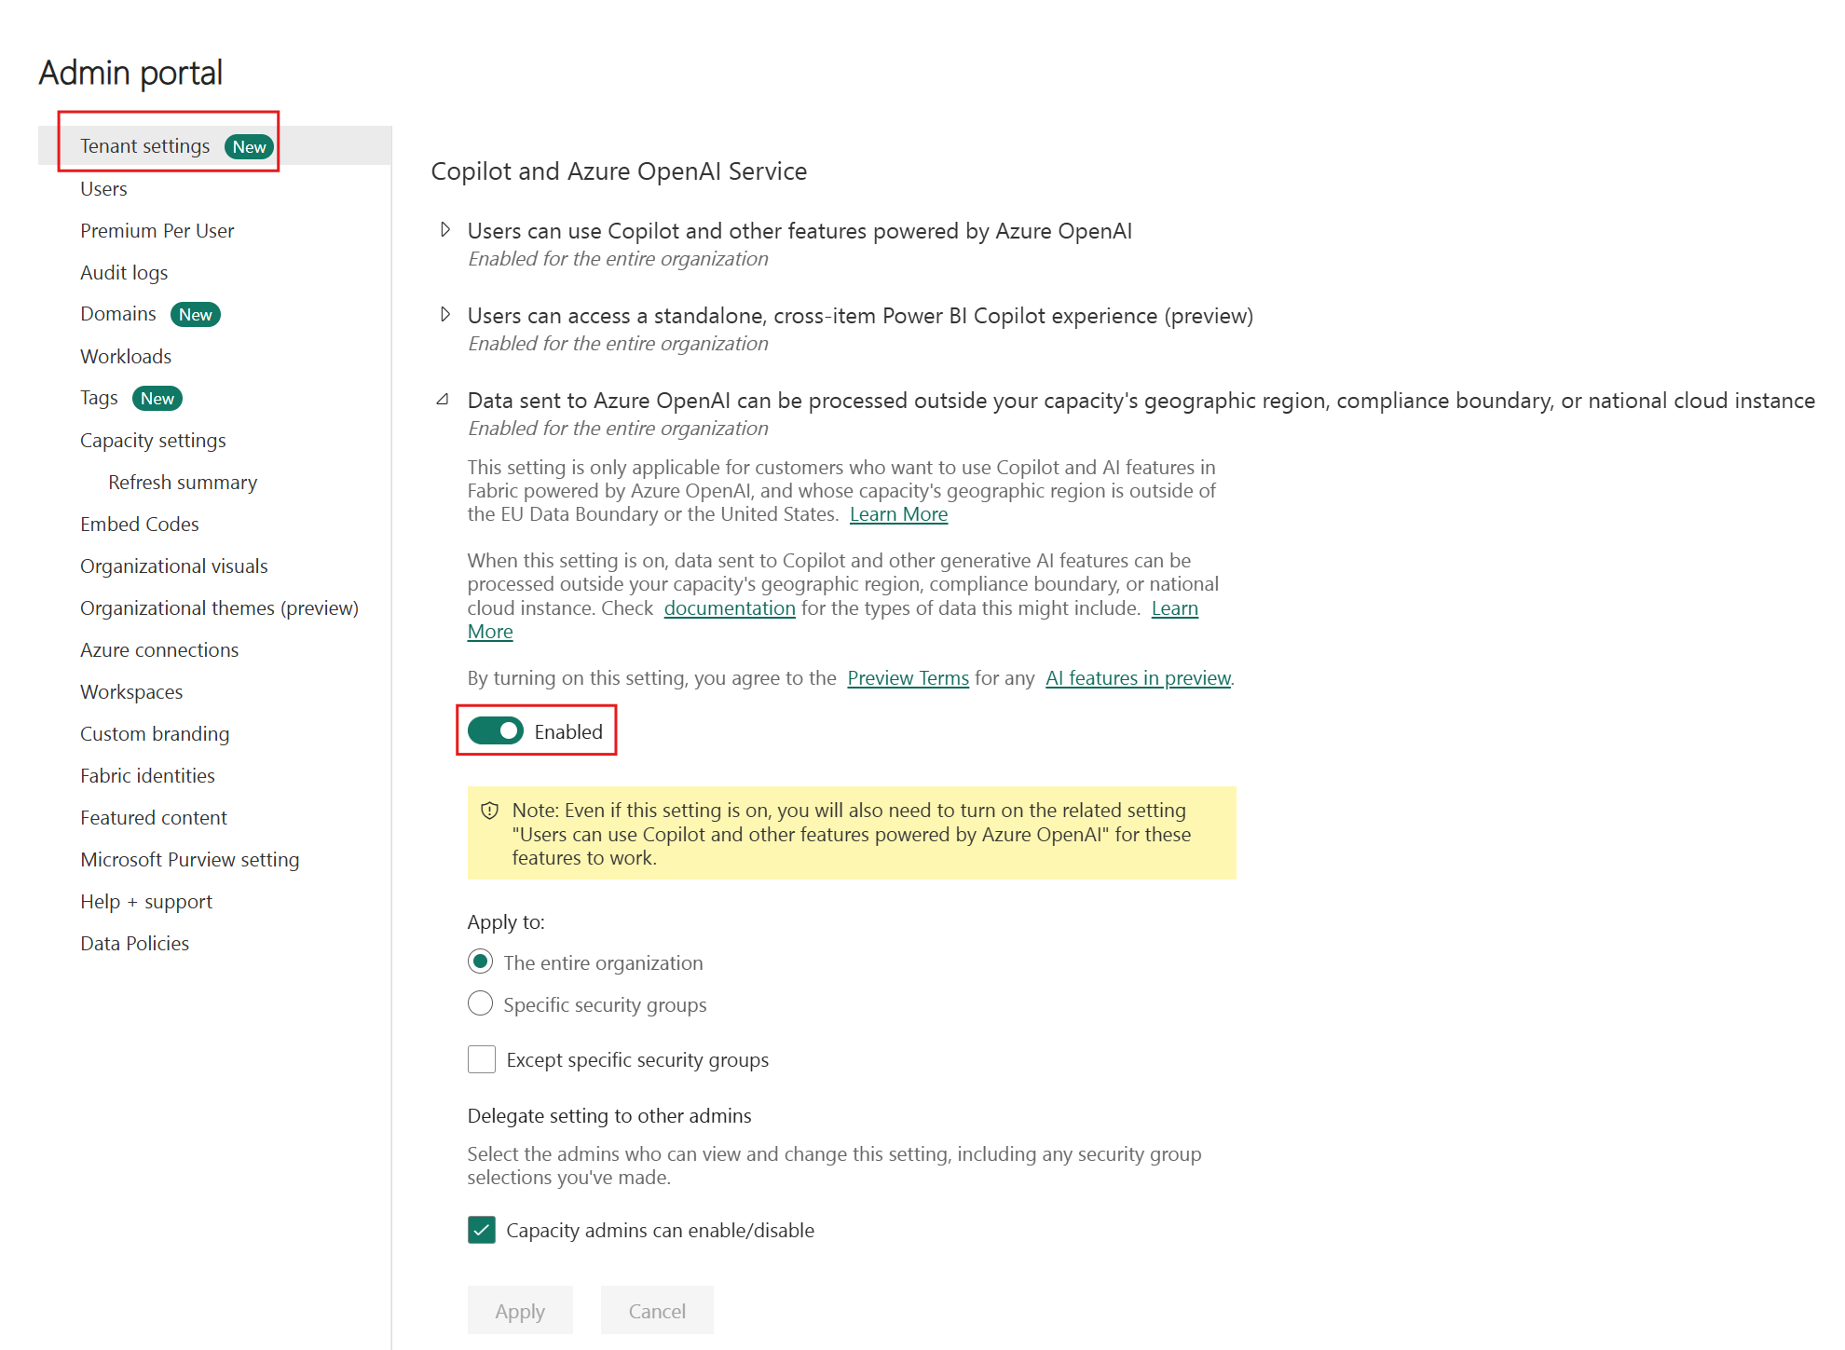
Settings for Copilot Tenants
This setting is only applicable for customers who want to use Copilot and AI features in Fabric powered by Azure OpenAI, and whose capacity's geographic region is outside of the EU data boundary and the US. When this setting is enabled, service background jobs may execute across geographic boundaries at no charge to the tenant capacity to support end user experiences.
Default: Disabled

Slide 6
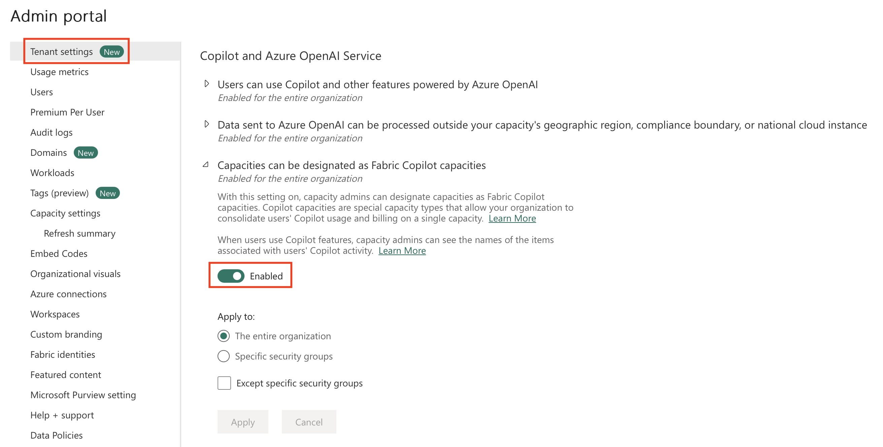
Settings for Copilot Tenants
Copilot capacities enable users' usage and billing to be consolidated under a single capacity. Fabric administrators can assign specific groups or the entire organization to manage capacities as Fabric Copilot capacities. Capacity administrators must designate user access to each Copilot capacity and can view item names linked to users' Copilot activity in the Fabric capacity metrics app.

Slide 7
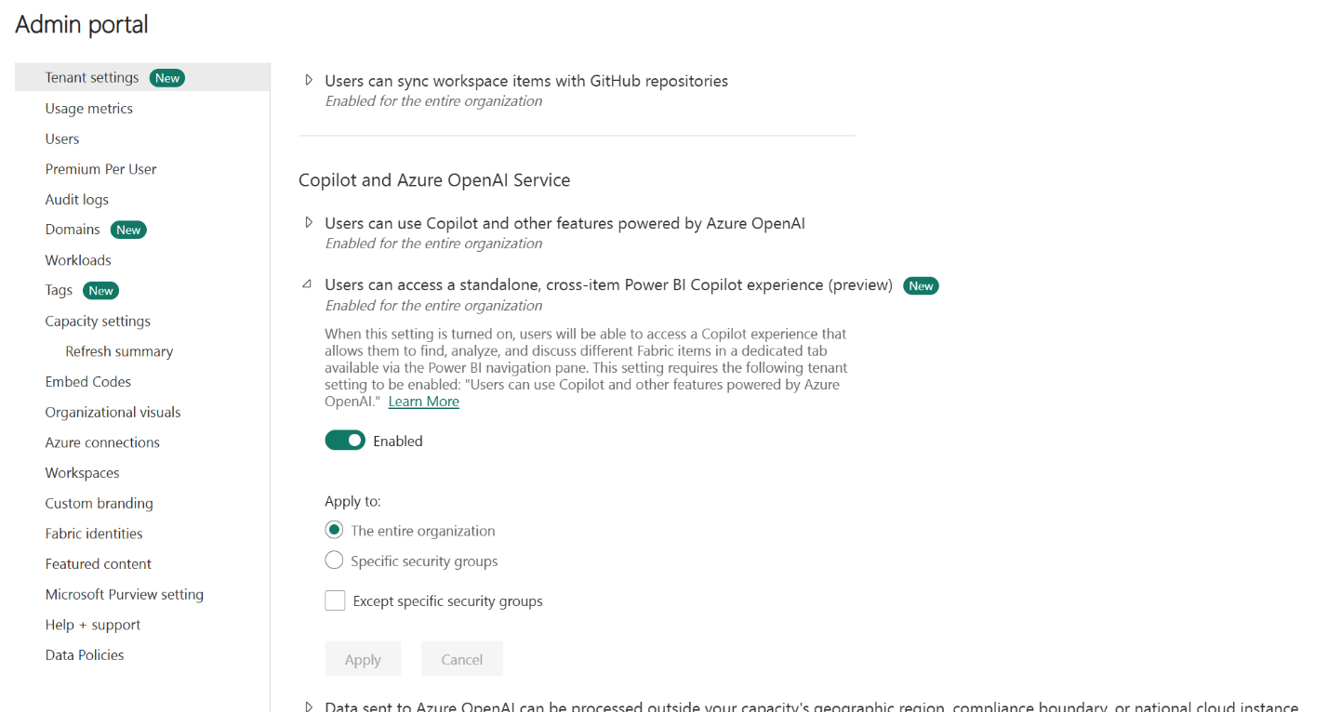
Users can access a standalone, cross-item Power BI Copilot experience (preview)
You can enable copilot as a standalone experience for Fabric. Enabling this setting allows users to access the standalone Copilot experience from the left navigation.
This setting also affects the Power BI agent. Turn on this setting to enable the Power BI agent in Microsoft 365.

Slide 8
Enable Fabric Copilot for Power BI
Section | Key Points
Applies to | Power BI Desktop and Power BI Service. (Microsoft Learn)
Purpose | Helps organisations enable and start using Copilot in Microsoft Fabric (and specifically in Power BI). (Microsoft Learn)
Prerequisites / Admin Steps (Tenant level) | • In the Fabric Admin portal: go to Tenant settings. • Enable the setting “Users can use Copilot and other features powered by Azure OpenAI”. (Microsoft Learn) • Specify which users/groups it applies to. (Microsoft Learn)
Data-sharing / Geolocation setting | If Azure OpenAI is not available in the organisation’s region, admins must enable: “Data sent to Azure OpenAI can be processed outside your capacity’s geographic region/compliance boundary”. (Microsoft Learn)
Capacity-level enablement | Admins can delegate Copilot enablement to capacity admins (for specific Fabric capacities). If tenant-level is off, a capacity admin can still enable Copilot for their capacity if delegated. (Microsoft Learn)
Standalone Power BI Copilot experience (Preview) | • There is a tenant setting “Users can access a standalone, cross-item Power BI Copilot experience (preview)”. (Microsoft Learn) • Note: Standalone Copilot will be enabled by default (from ~Sep 5 2025) for tenants with Copilot already turned on. (Microsoft Learn) • Not supported in all regions. (Microsoft Learn)
Using Copilot in Power BI Service | • Workspace must be in a Premium Power BI capacity (P1 or higher) or paid Fabric capacity (F2 or higher) for Copilot to be available. (Microsoft Learn) • Verify workspace settings via Workspace > Settings > Premium/Fabric capacity. (Microsoft Learn)
Using Copilot in Power BI Desktop | • The Copilot button appears in the ribbon. (Microsoft Learn) • To use: you must have access (admin/member/contributor) to at least one workspace in a supported capacity (paid Fabric or Premium) and Copilot enabled. (Microsoft Learn) • On first use, you’ll be prompted to select a supported workspace. (Microsoft Learn)
Licensing / Capacity Requirements | • Only paid SKUs/capacities supported (e.g., not trial SKUs). (Microsoft Learn) • Your capacity must be in a supported region for Fabric/Copilot. (Microsoft Learn)
Considerations & Limitations | • Some regions are not yet supported for standalone Copilot. (Microsoft Learn) • Not currently supported in sovereign clouds due to GPU availability. (Microsoft Learn) • Workspace must meet capacity/licensing; if not, users may see errors or disabled features. (blog.atwork.at)
Last updated | October 16, 2025. (Microsoft Learn)

Slide 9
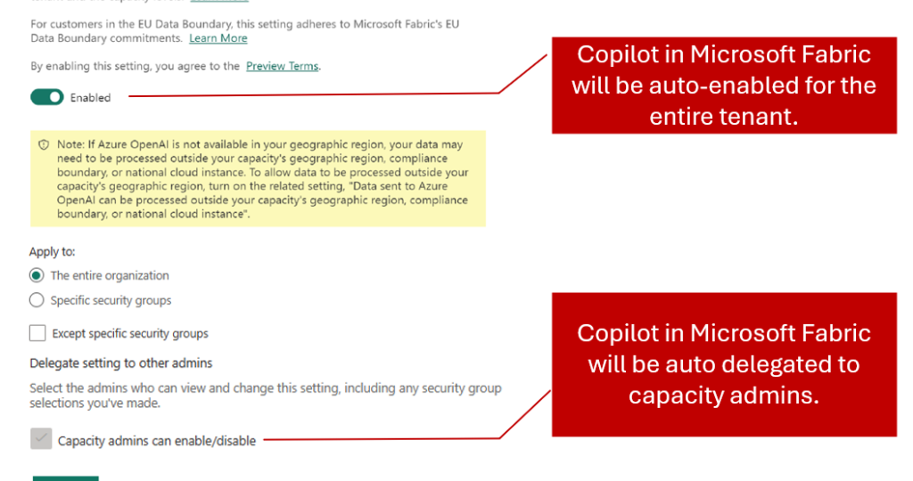

Slide 10
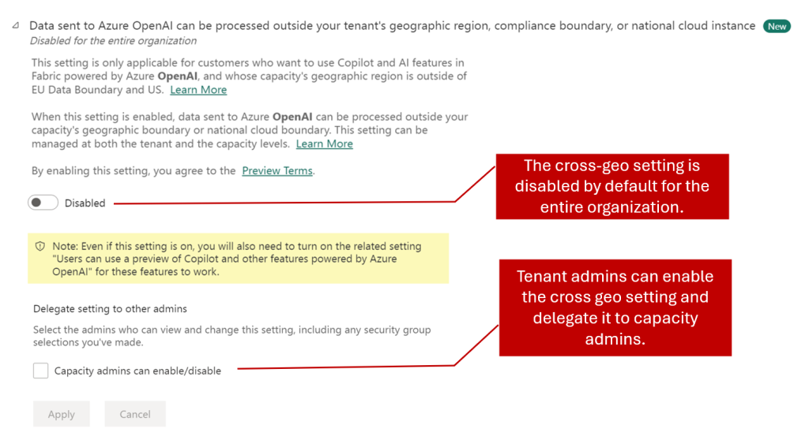

Slide 11
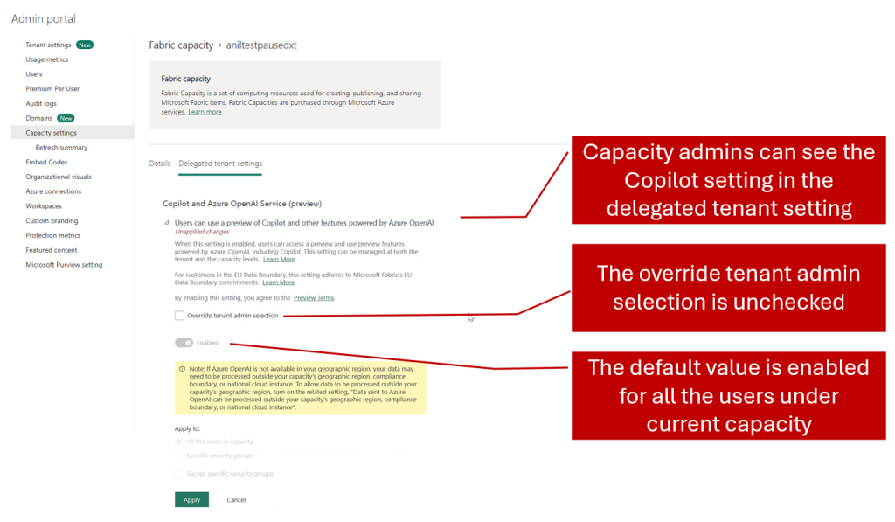

Slide 12


Slide 13
 | CU per Hour | CU per Minute | Example Token Usage
F2 | 2 | 7,200 | 120 | 2,000 input + 500 output tokens ≈ 6.67 CU-min
F4 | 4 | 14,400 | 240 | Same request ≈ 3.33 CU-min
F8 | 8 | 28,800 | 480 | Same request ≈ 1.67 CU-min
F16 | 16 | 57,600 | 960 | Same request ≈ 0.83 CU-min
F32 | 32 | 115,200 | 1,920 | Same request ≈ 0.42 CU-min
F64 | 64 | 230,400 | 3,840 | Same request ≈ 0.21 CU-min

Slide 14
# | Experience | What it is | Best for
1 | Copilot inside a Power BI report | Copilot pane that chats about the current report / semantic model, can build visuals, summarize and explore data in-context. | Business users exploring a specific report; analysts building or refining that report.
2 | Standalone Copilot in Power BI | Full-screen Copilot experience in Power BI that can search and chat over any report, semantic model, and Fabric data agent the user can access. | RMs / execs who want a “single Copilot for analytics” across many reports/models.
3 | Fabric Data Agent (standalone) | A conversational Q&A agent defined in Fabric that can query lakehouses, warehouses, Power BI semantic models, KQL DBs, etc. | Building domain-specific “data brains” (e.g. Institutional Banking data agent, Risk data agent).
4 | Fabric Data Agent integrated into Copilot Studio | A Fabric data agent added as a connected agent inside Copilot Studio, so your Copilot Studio agent can call it for data Q&A while also using tools, topics, connectors, and other agents. | Enterprise copilots (in Teams, web, apps) that need Fabric data + business workflows + external systems (CRM, tickets, line-of-business apps).
5 | Copilot Studio agent with Power BI connector to query datasets | Copilot Studio agent that calls the Power BI connector / APIs to execute queries against datasets, read reports, or trigger alerts. | When you mainly need Power BI metrics but don’t (yet) have Fabric data agents, or you need very custom query logic / actions around a single dataset.

